Slide 1
MES13 RNA-Seq Data Analysis Using DEGSeq R Package
Davit Sargsyan
March 2018

Slide 2
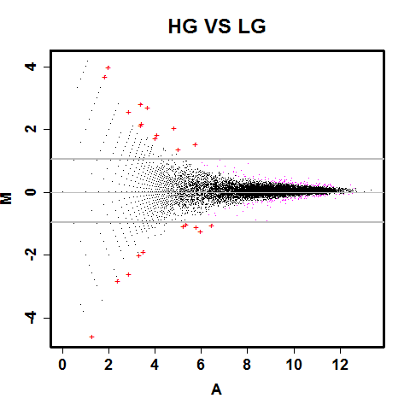
GeneNames | HG | LG | log2(Fold_change) | log2(Fold_change) normalized | z-score | p-value | q-value (Benjamini et al. 1995) | q-value (Storey et al. 2003) | Signature (q-value (Storey et al. 2003) < 0.1)
Mab21l3 | 94 | 32 | 1.555 | 1.513 | 5.494 | 0.000 | 0.000 | 0.000 | TRUE
Kap | 58 | 14 | 2.051 | 2.010 | 5.258 | 0.000 | 0.000 | 0.000 | TRUE
Col4a2 | 41 | 97 | -1.242 | -1.283 | -4.996 | 0.000 | 0.000 | 0.000 | TRUE
Igfbp2 | 62 | 127 | -1.034 | -1.076 | -4.966 | 0.000 | 0.000 | 0.000 | TRUE
5330417C22Rik | 33 | 5 | 2.722 | 2.681 | 4.710 | 0.000 | 0.001 | 0.001 | TRUE
Acsm2 | 28 | 4 | 2.807 | 2.766 | 4.411 | 0.000 | 0.003 | 0.003 | TRUE
Upk3b | 38 | 81 | -1.092 | -1.133 | -4.137 | 0.000 | 0.007 | 0.007 | TRUE
Fam159b | 16 | 1 | 4.000 | 3.959 | 3.881 | 0.000 | 0.015 | 0.015 | TRUE
Lrrc15 | 52 | 20 | 1.379 | 1.337 | 3.723 | 0.000 | 0.023 | 0.022 | TRUE
Hes2 | 32 | 9 | 1.830 | 1.789 | 3.612 | 0.000 | 0.031 | 0.030 | TRUE
Zic2 | 0 | 12 | -4.585 | -4.626 | -3.549 | 0.000 | 0.037 | 0.036 | TRUE
Ankrd61 | 3 | 18 | -2.585 | -2.626 | -3.489 | 0.000 | 0.044 | 0.043 | TRUE
Gm15708 | 23 | 5 | 2.202 | 2.161 | 3.468 | 0.001 | 0.047 | 0.046 | TRUE
Hsd3b2 | 13 | 1 | 3.700 | 3.659 | 3.406 | 0.001 | 0.055 | 0.054 | TRUE
Trabd2b | 26 | 55 | -1.081 | -1.122 | -3.382 | 0.001 | 0.059 | 0.058 | TRUE
Akap5 | 18 | 3 | 2.585 | 2.544 | 3.380 | 0.001 | 0.059 | 0.058 | TRUE
Plb1 | 30 | 9 | 1.737 | 1.696 | 3.370 | 0.001 | 0.060 | 0.059 | TRUE
Col7a1 | 29 | 59 | -1.025 | -1.066 | -3.360 | 0.001 | 0.062 | 0.060 | TRUE
Ovol1 | 22 | 5 | 2.138 | 2.096 | 3.328 | 0.001 | 0.067 | 0.065 | TRUE
Il23r | 2 | 14 | -2.807 | -2.848 | -3.212 | 0.001 | 0.087 | 0.085 | TRUE
Cnn1 | 6 | 22 | -1.874 | -1.916 | -3.183 | 0.001 | 0.092 | 0.090 | TRUE
Atp2a1 | 5 | 20 | -2.000 | -2.041 | -3.164 | 0.002 | 0.097 | 0.095 | TRUE

Slide 3
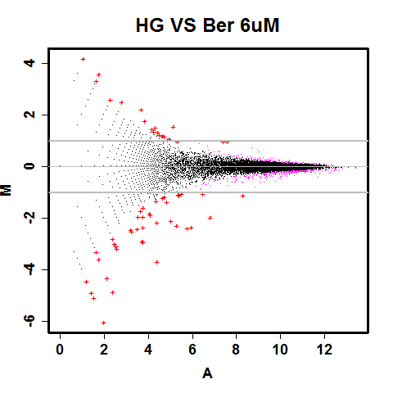

Slide 4
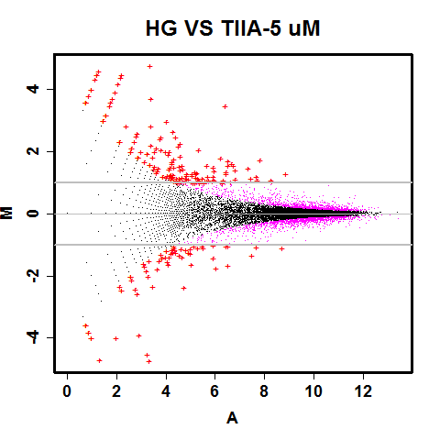
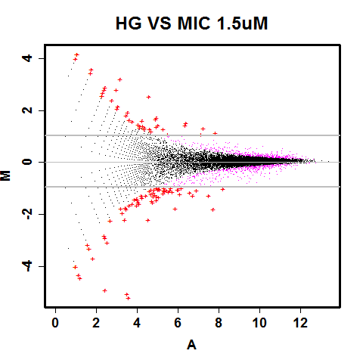

Slide 5
